Slide 1
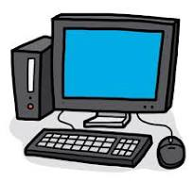
How to
Set Up a Server and a Client

Slide 2
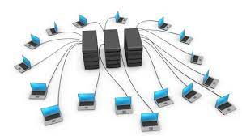
The First Internet: ARPANET
Using a computer required sitting at a terminal connected to a central computer (mainframe)
Paul Baran developed the idea of packet communication (small groups of data sent along different paths to a destination)
Robert Taylor had 3 different computer terminals connected to 3 mainframe computers in his office→Can one terminal be used for a computer?
Notes:
Keyboard for input, printer for output (no screen). In the early 1960s, Paul Baran, developed the concept of distributed adaptive message block switching. This would enable small groups of data to be sent along differing paths to the destination. This idea eventually became packet communication that underlies almost all data communication today.Robert credits the idea of ARPANET to the fact that he had three different computer terminals connected to three mainframe computers in his office that he would need to move between.

Slide 3
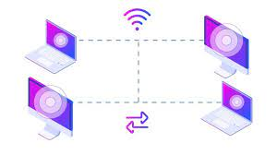
Transmission Control Protocol (TCP)
Enables communication between different networks by providing universal standard for data transmission
Simplifies the complexity of each network's operations, enabling devices to communicate regardless of the specific technologies or equipment
Notes:
standard that defines how to establish and maintain a network conversation by which applications can exchange data. Created in 1974. Ensures reliable transmission of packets . TCP is connection-oriented, and a connection between client and server is established before data can be sent. The server must be listening (passive open) for connection requests from clients before a connection is established.

Slide 4
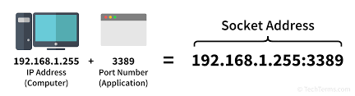
Sockets and Ports
A socket is one endpoint of a two-way communication link between two programs running on the network; identified by IP Address and Port number
A socket is bound to a port number so the TCP layer can uniquely identify a connection endpoint and direct data to its specific destination

Slide 5
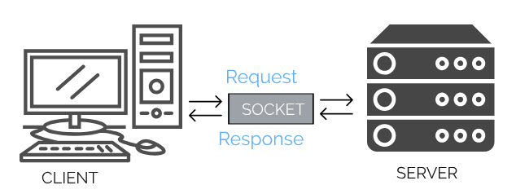
Socket Programming
Way of connecting two nodes on a network to communicate, using TCP/IP protocols through sockets→establishes a connection between a client and a server
A server waits for a connection from the client, who initiates the connection

Slide 6
The Berkeley Socket (1983)
Berkeley Software Distribution version of Unix
API implementation of the TCP protocol used by all operating systems
Function call is the same for other programming languages

Slide 7
Server
socket()
bind()
listen()
accept()
recv()
send()
close()
Client
socket()
connect()
send()
recv()
close()

Slide 8
Code Requirements
Create a socket (both client and server)
(Server) Bind the socket to a specific local address (machine's IP address) and port number
(Server) Passively listens for incoming connections

Slide 9
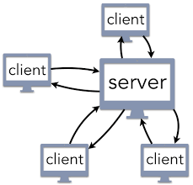
Multiple Client Connections
For multiple client connections to one port, distinguish between clients with the source IP Address
Distinguish between multiple connections from the same IP address with the incoming packet’s source IP address and port number

Slide 10
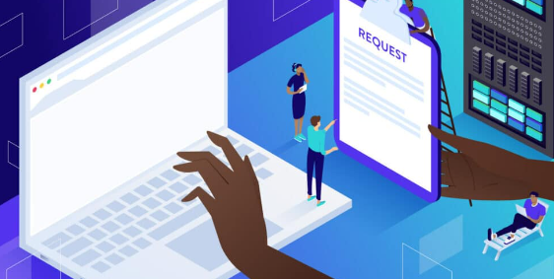
Everyday Server Use
Hypertext Transfer Protocol (HTTP):
request-response protocol
allows interaction with web resources by transmitting hypertext messages between clients and servers

Slide 11

Google Search
The client initiates a TCP connection to the server by creating a socket; the server accepts
The client sends an HTTP request over the established TCP connection.
The server sends an HTTP response back to client (the image) over the same TCP connection.

Slide 12

Demo: Create a Simple Chat Program

Slide 13

realpython.com:
Offers detailed guide of Python Socket Implementation
Geeks for Geeks
Client-Server in C, Java
techtarget.com
Articles on related concepts
More Resources

Slide 14
Thank you! Questions?

Slide 15
Works Cited
https://www.cs.rpi.edu/~moorthy/Courses/os98/Pgms/socket.html
https://www.techtarget.com/searchnetworking/definition/ARPANET
https://www.techtarget.com/searchnetworking/definition/TCP
https://enzircle.hashnode.dev/introduction-to-socket-programming

